Slide 1
Secure data hiding in images using steganography
CAPSTONE PROJECT
Presented By:
Krishna Sri Kanduri
NRI INSTITUTE OF TECHNOLOGY
CSE

Slide 2
OUTLINE
Problem Statement
Technology used
Wow factor
End users
Result
Conclusion
Git-hub Link
Future scope

Slide 3
Problem Statement
Develop a robust and secure steganography technique to hide sensitive data within digital images while minimizing perceptual distortion and maximizing data capacity. The system will provide a valuable tool to address these security challenges by integrating advanced encryption algorithms, multi-factor authentication, real-time threat detection, and secure data storage protocols.

Slide 4
Technology used
.
.
Libraries:
OS: file and directory manipulation, environmental variable access and process management.
OpenCV(open source computer vision): provides extensive capabilities for image and video processing.
Pillow (PIL): A Python Imaging Library that provides easy-to-use methods for opening, manipulating, and saving image files
Platforms:
IDLE(Integrated Development & Learning Environment):IDLE provides an interactive Python shell (REPL) where users can execute Python commands and see the results immediately. This is useful for testing small snippets of code quickly.
OpenStego: An open-source tool for steganography, allowing users to hide data in images.

Slide 5
Wow factors
Enhanced Security:steganography hides data within innocuous files (like images), making it less likely to attract attention.
High Capacity for Data Hiding: large data storage and adaptive techniques .
Versatility Across Formats: Steganography can be applied to various image formats (JPEG, PNG, BMP, etc.), allowing for flexibility in choosing the medium for data hiding.
User -Friendly Implementation: Accessible libraries and tools , Graphical user interfaces.
Imperceptibility: The human eye is not sensitive to minor changes in pixel values, allowing for effective data hiding without detection.
Integration with Emerging Technologies: Machine learning , Blockchain.
Legal and Ethical Applications:privacy protection , secure data sharing

Slide 6
End users
Organizations: Individuals:
Businesses privacy-Conscious users
Government agencies Whistleblowers
Military Circumventing censorship
Cybercriminals: Other users:
Malware distributors Artists
Data thieves Historians
Organized crime

Slide 7
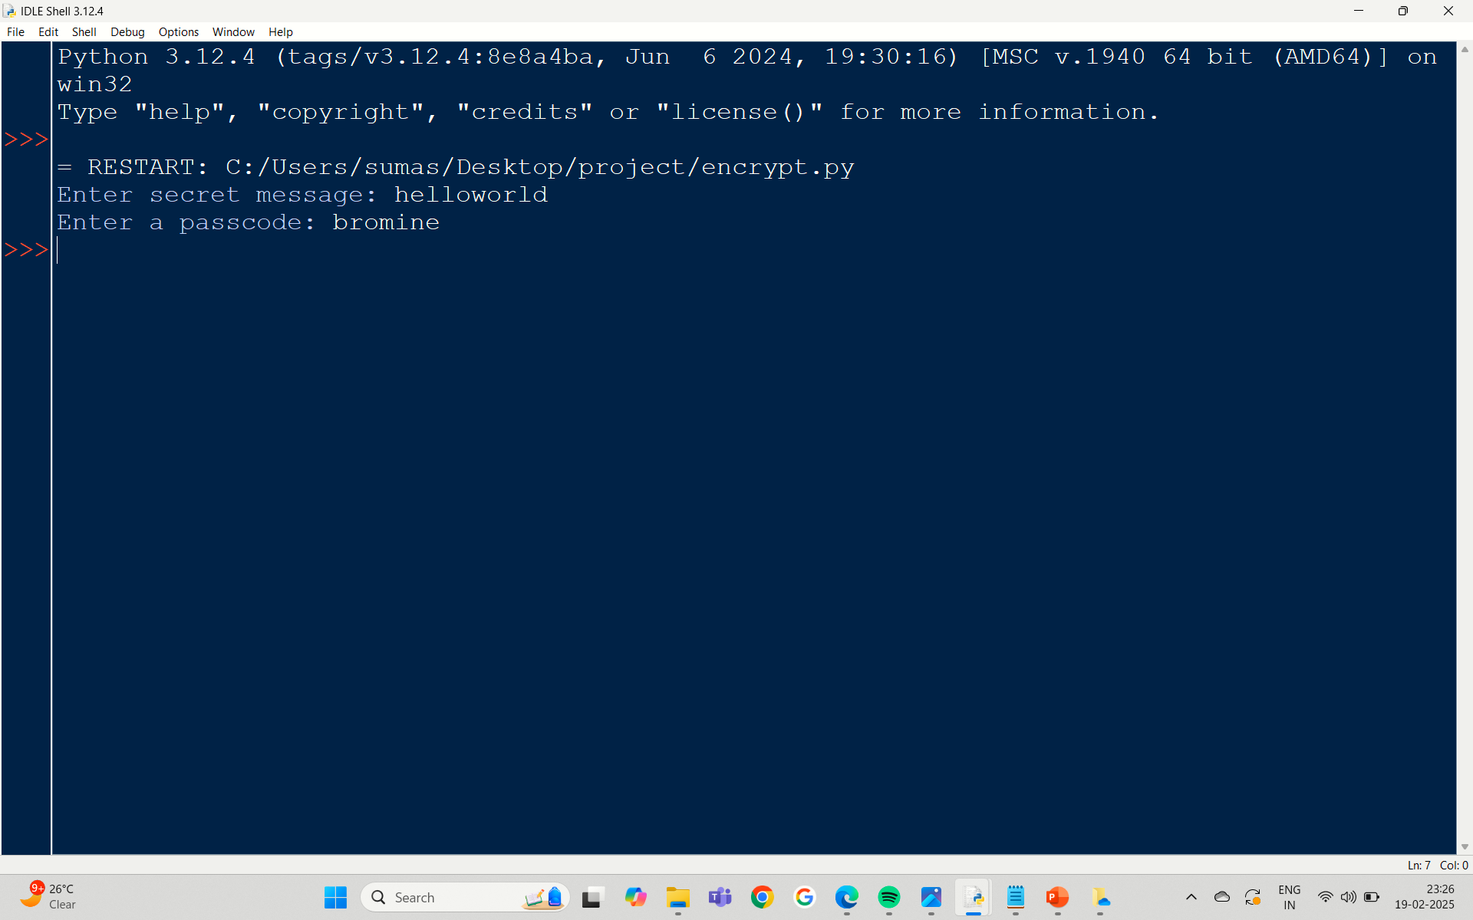
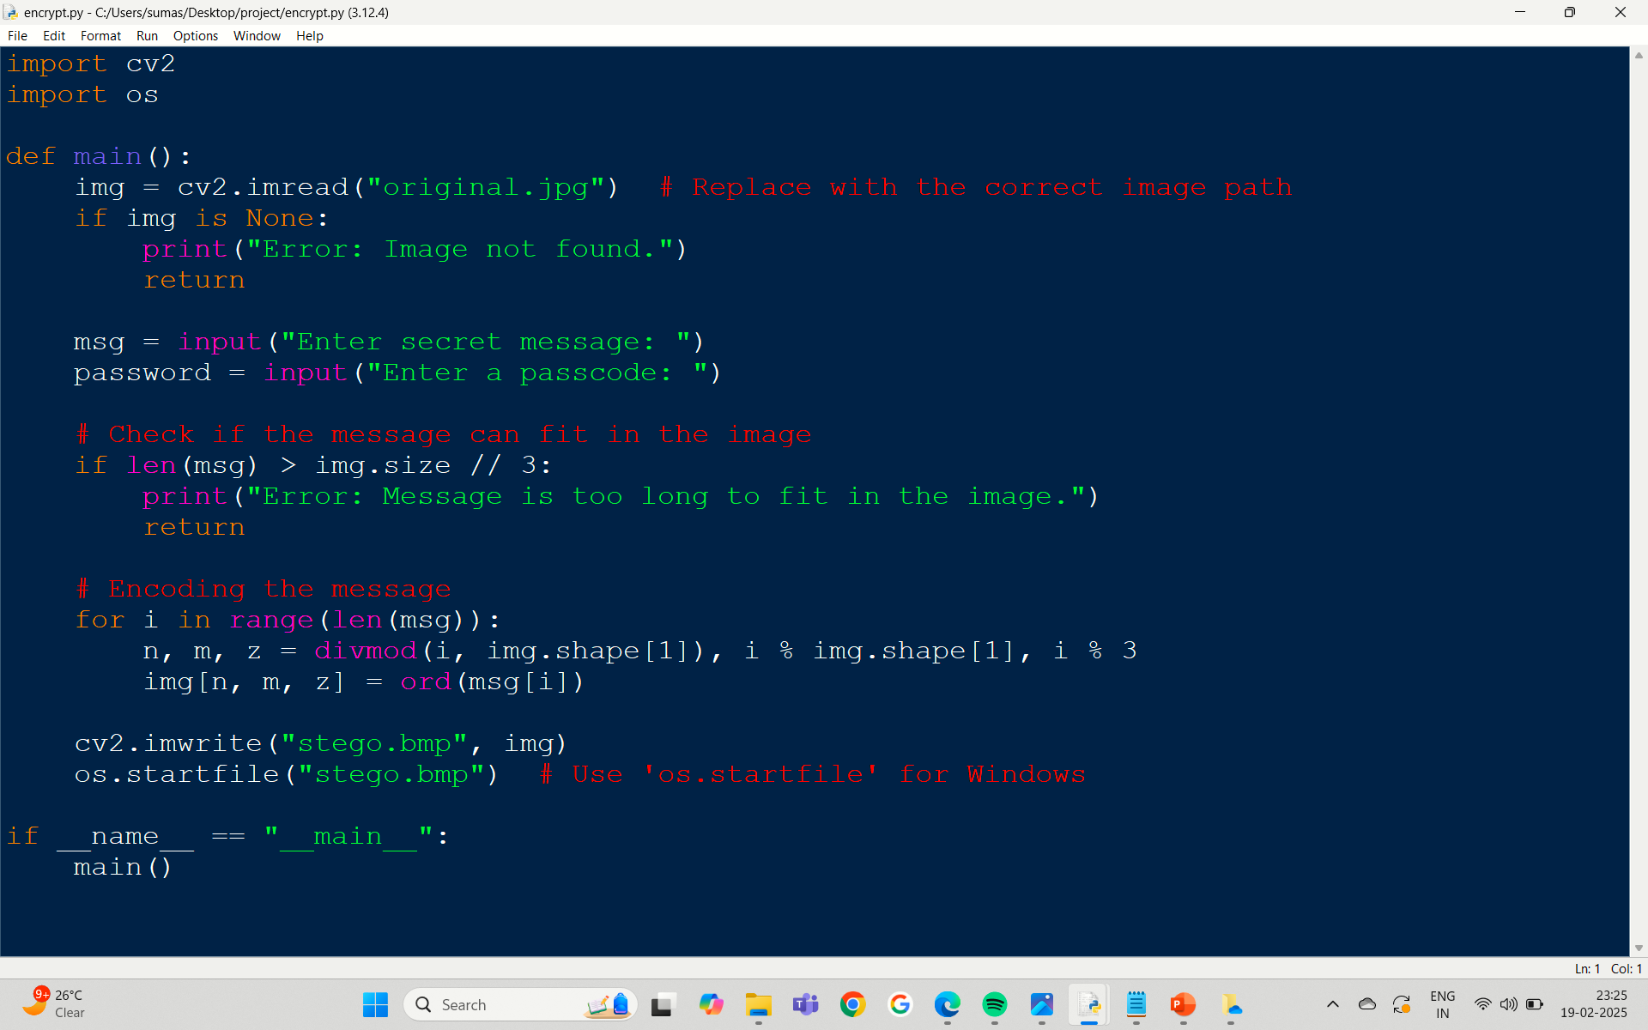
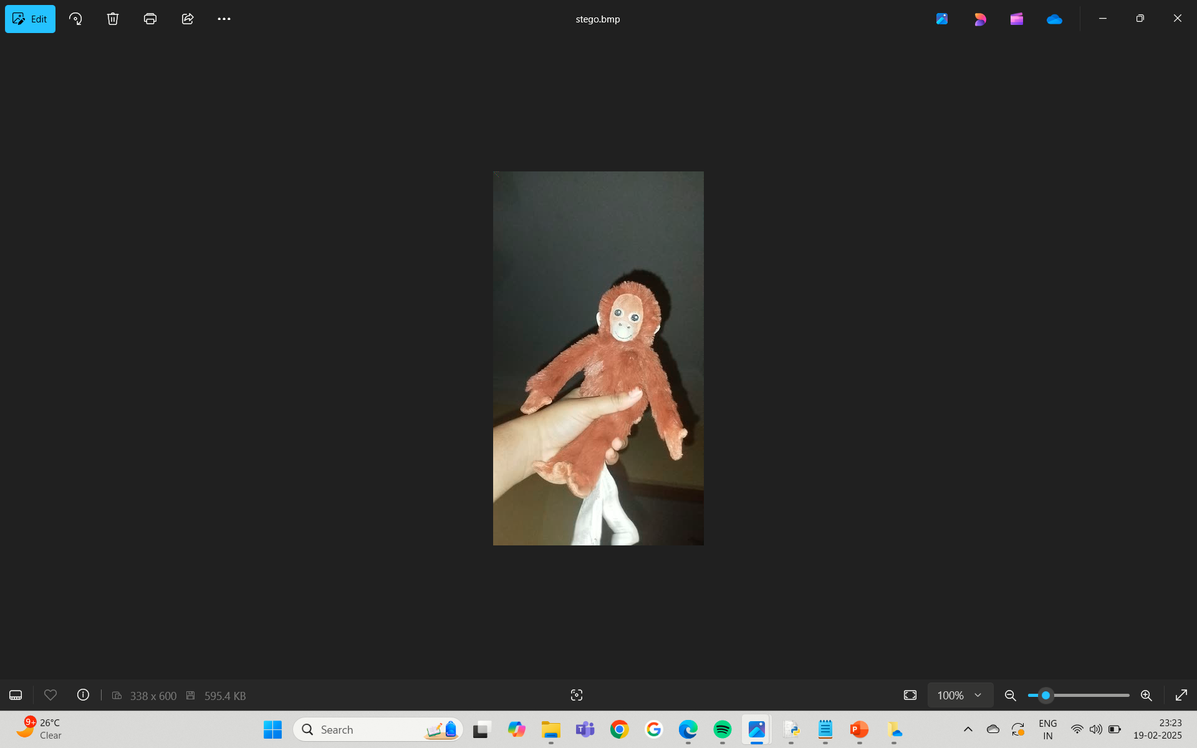
Results
Encryption:

Slide 8
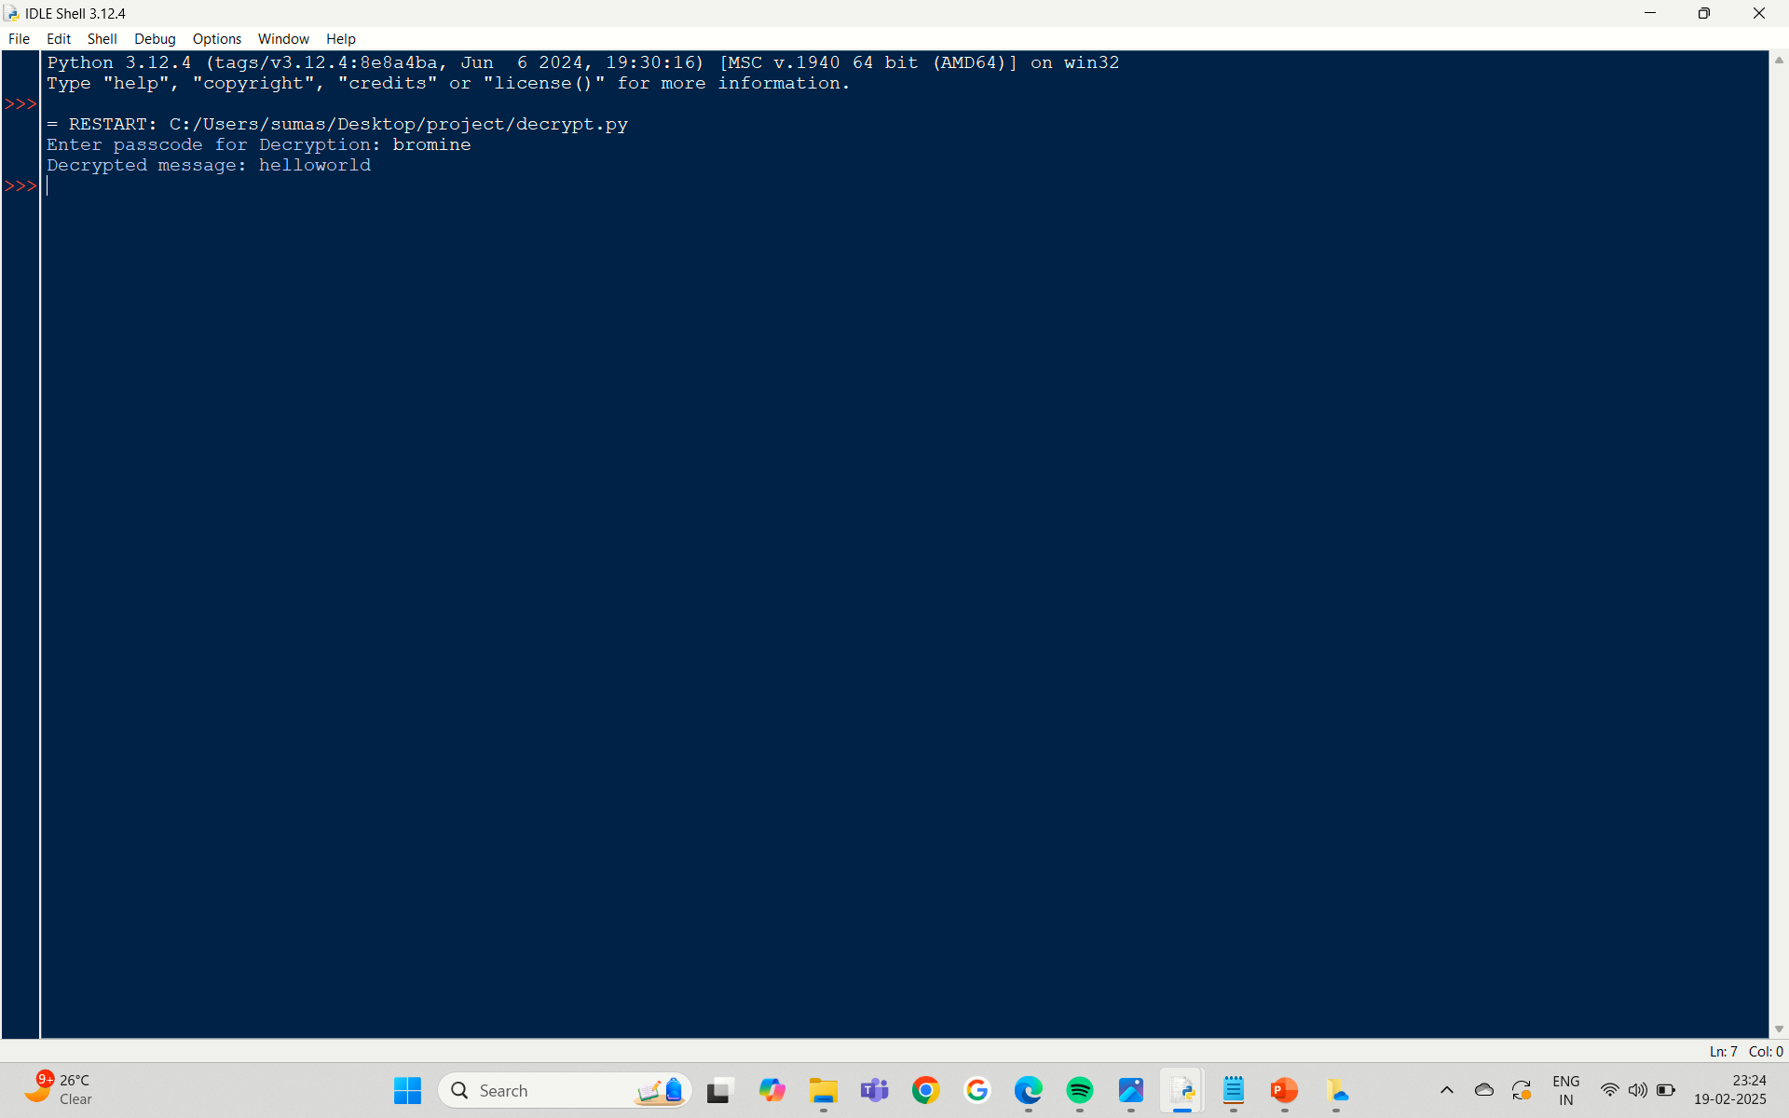
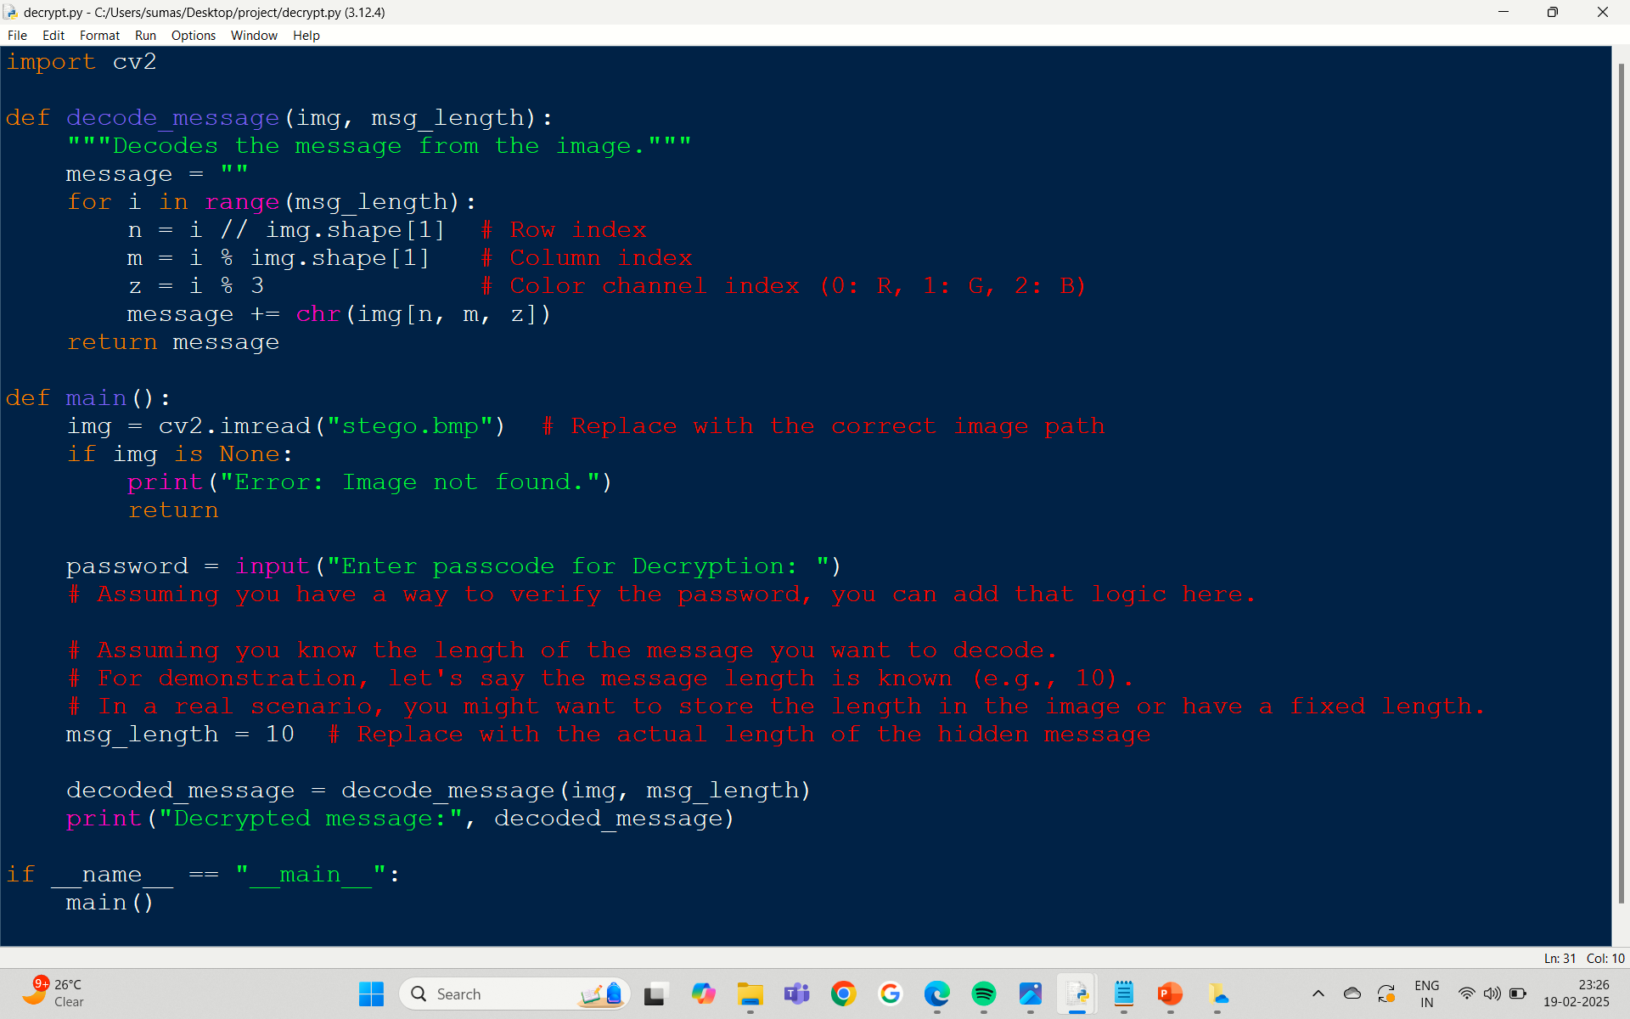
results
Decryption:

Slide 9
Conclusion
In summary, Image steganography is a powerful tool for secure data hiding, offering a covert channel for transmitting sensitive information. By embedding data within images, it provides a means of communication that is difficult to detect. While not a replacement for encryption, steganography offers an additional layer of security, making it a valuable technique in the realm of data protection. As technology advances, steganography continues to evolve, with new techniques and algorithms being developed to enhance its effectiveness and security.
Here's a breakdown of its key strengths:
Concealment: Unlike encryption, which makes data unreadable, steganography hides the very existence of the message. This makes it less likely to attract unwanted attention.
Versatility: Steganography can be applied to various image formats and can be combined with encryption for enhanced security.
Evolution: As technology advances, so do steganographic techniques, ensuring its continued relevance in the face of evolving threats.

Slide 10
GitHub Link
https://github.com/Krishnasri-kanduri/cyber-security

Slide 11
Future scope(optional)
The future of secure data hiding in images using steganography is promising, with advancements in techniques like digital watermarking and machine learning enhancing data concealment methods. Ongoing research focuses on improving security measures and efficiency, making steganography a vital tool in information protection.
Emerging Trends in Steganography:
Machine Learning Integration: The use of machine learning algorithms is becoming prevalent in automating the data hiding process, enhancing both the efficiency and security of steganographic techniques. This allows for more sophisticated methods that are harder for adversaries to detect.
Blockchain Technology: Integrating steganography with blockchain can provide tamper-proof data storage and transmission, ensuring the integrity and security of hidden information.
Quantum Steganography: The exploration of quantum mechanics in steganography presents a new frontier for secure communication, offering unprecedented levels of security and privacy.

Slide 12
THANK YOU

